Slide 1
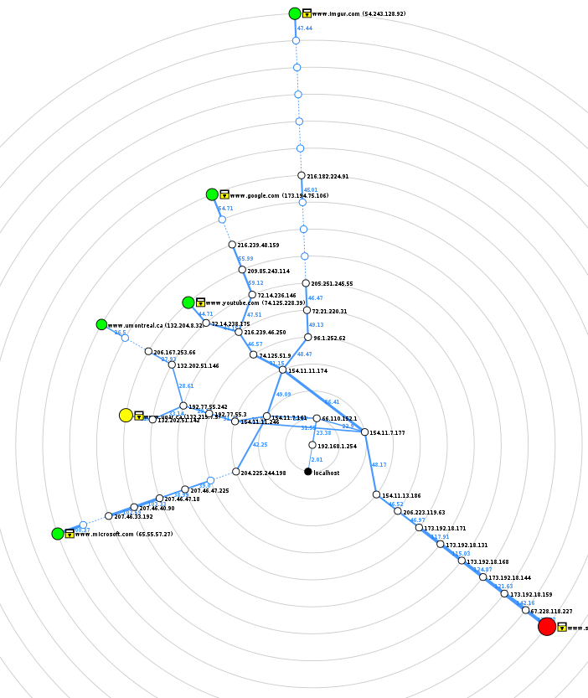

North Western University
Introduction to Computer Network Using NS2 Based on the Domain: Youtube
Course Title: Computer Networks Sessional
Course Code: CSE-3304

Slide 2



Team NWU_Youtube
Raihanul Islam Apu
Student ID: 20201133010
Department of CSE
North Western University, Khulna
Anisha Akter
Student ID: 20201119010
Department of CSE
North Western University, Khulna
MD Shahed Afridi
Student ID: 20201134010
Department of CSE
North Western University, Khulna

Slide 3
Overview
Introduction to Zenmap
Four Different Host to Domain: Youtube
Design Network Topology
Prepare Excel Sheet for Network Diagram
Introduction to Network Simulator 2
Source Code of NS2 Based on Network Diagram
Output Topology of Network Simulator 2
Summarization of the Design Network
Conclusion

Slide 4
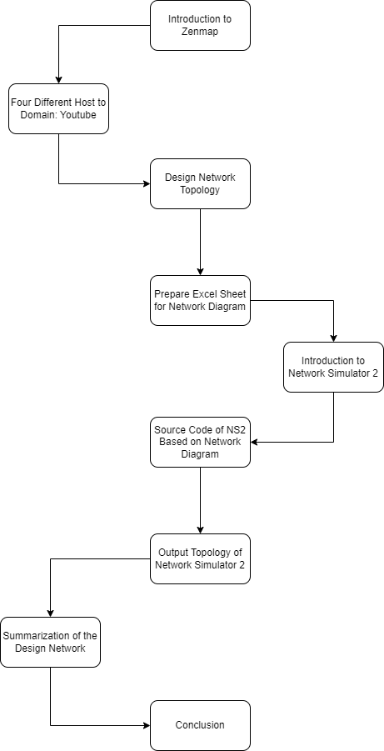
Bird’s Eye View of the Project

Slide 5
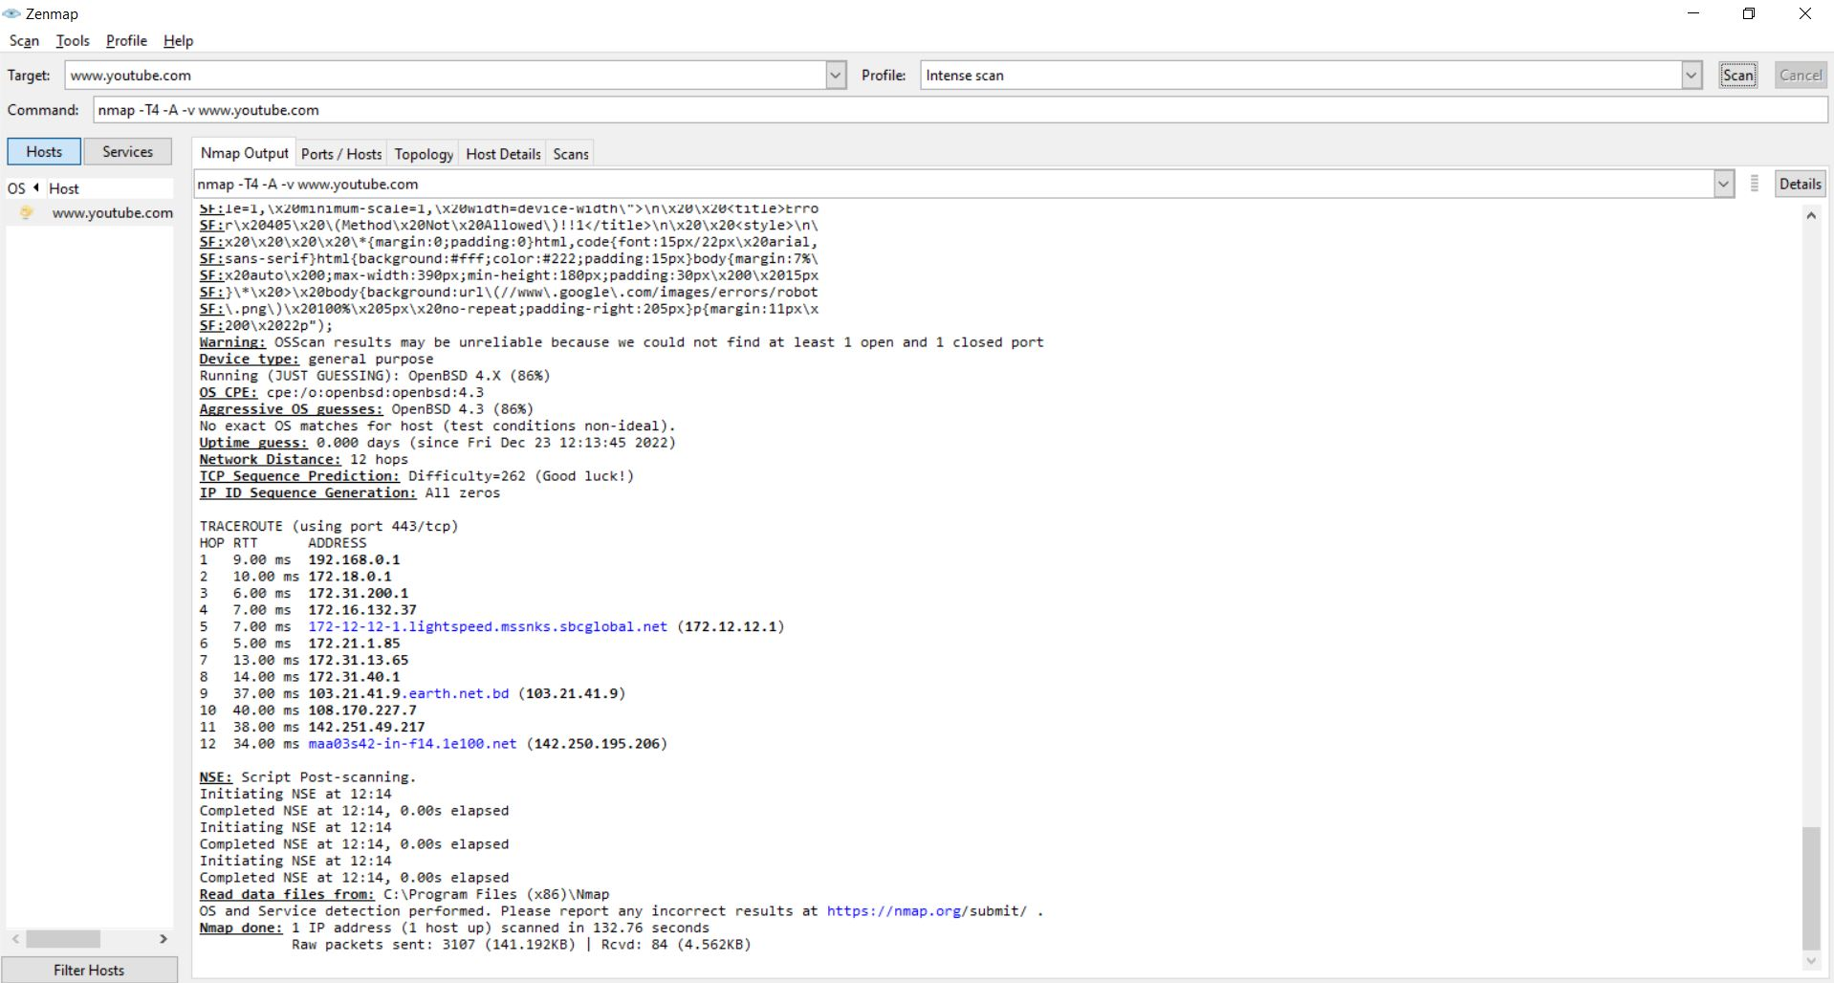
Introduction to Zenmap
Zenmap is an official Nmap Security scanner GUI (graphical user interface).
Zenmap lets you create a topology map of discovered networks.
It arranges its display to show all ports on a host or all hosts running a specific service.
In this project we used 4 different host to reached www.youtube.com website.

Slide 6
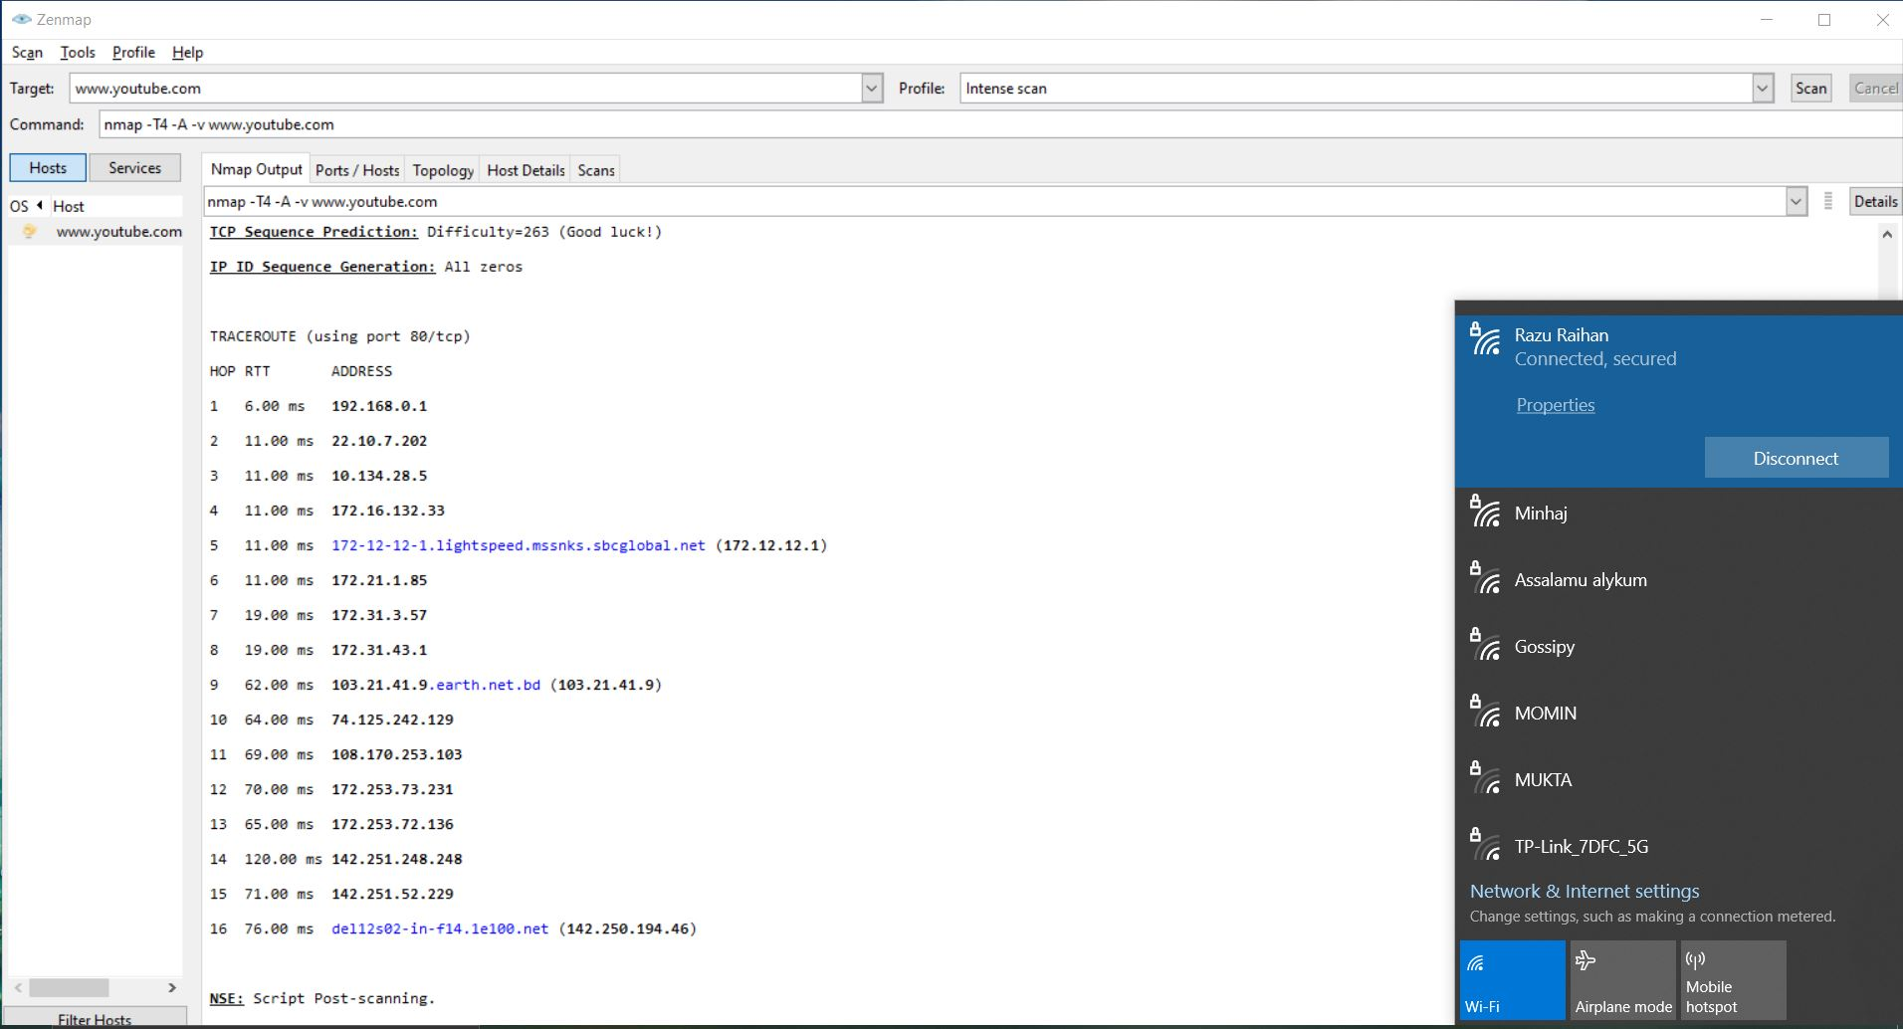
Four Different Host to Domain: Youtube
In this project we used 4 different host to reached www.youtube.com website.
Every host generates different IP addresses.
The scan result in zenmap
of Daulatput Online ISP

Slide 7
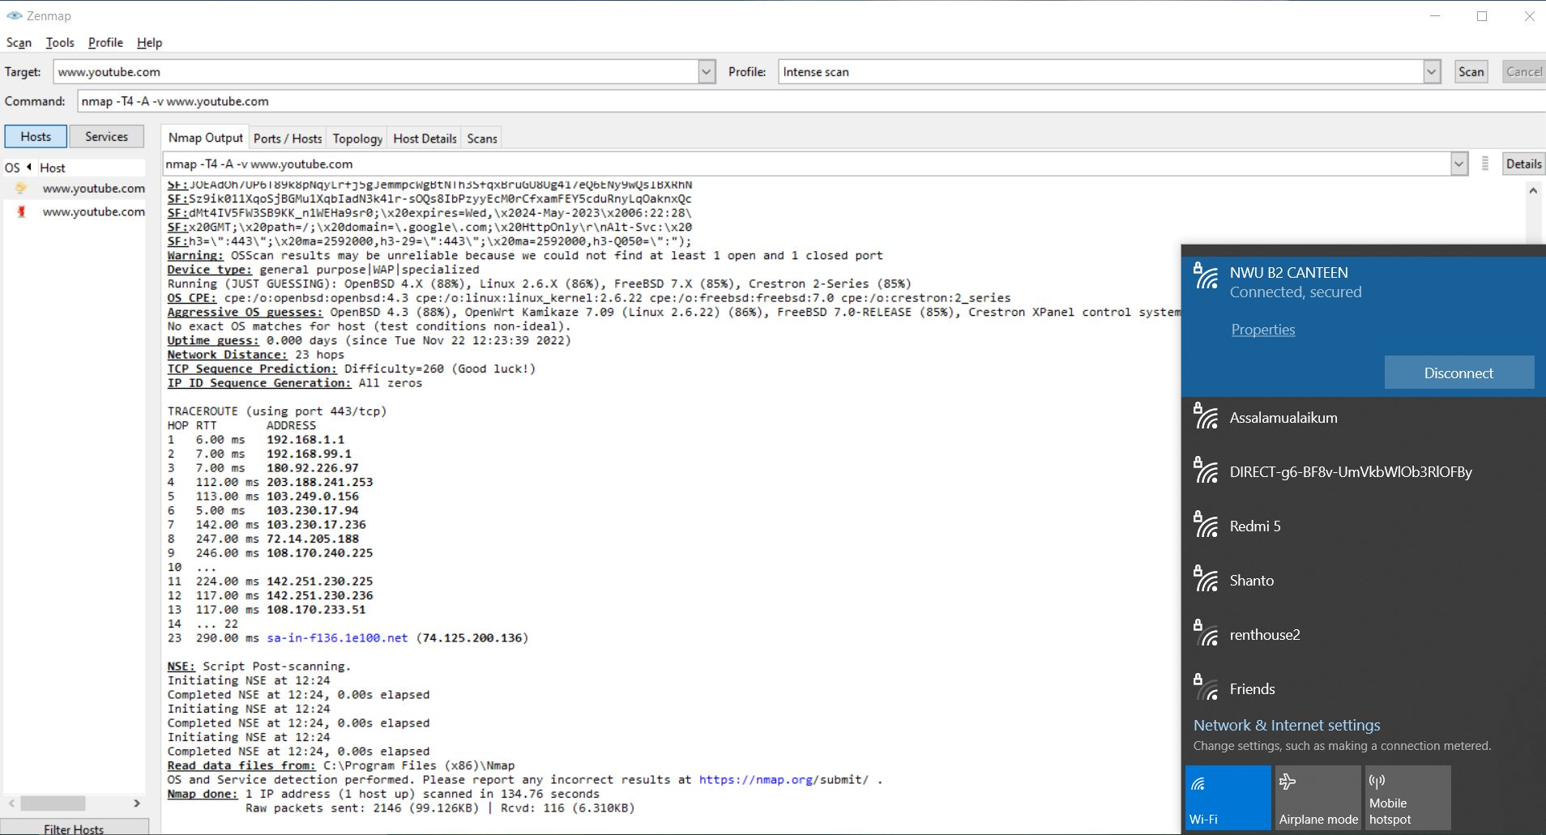
The scan result in zenmap of ISN Khulna ISP

Slide 8
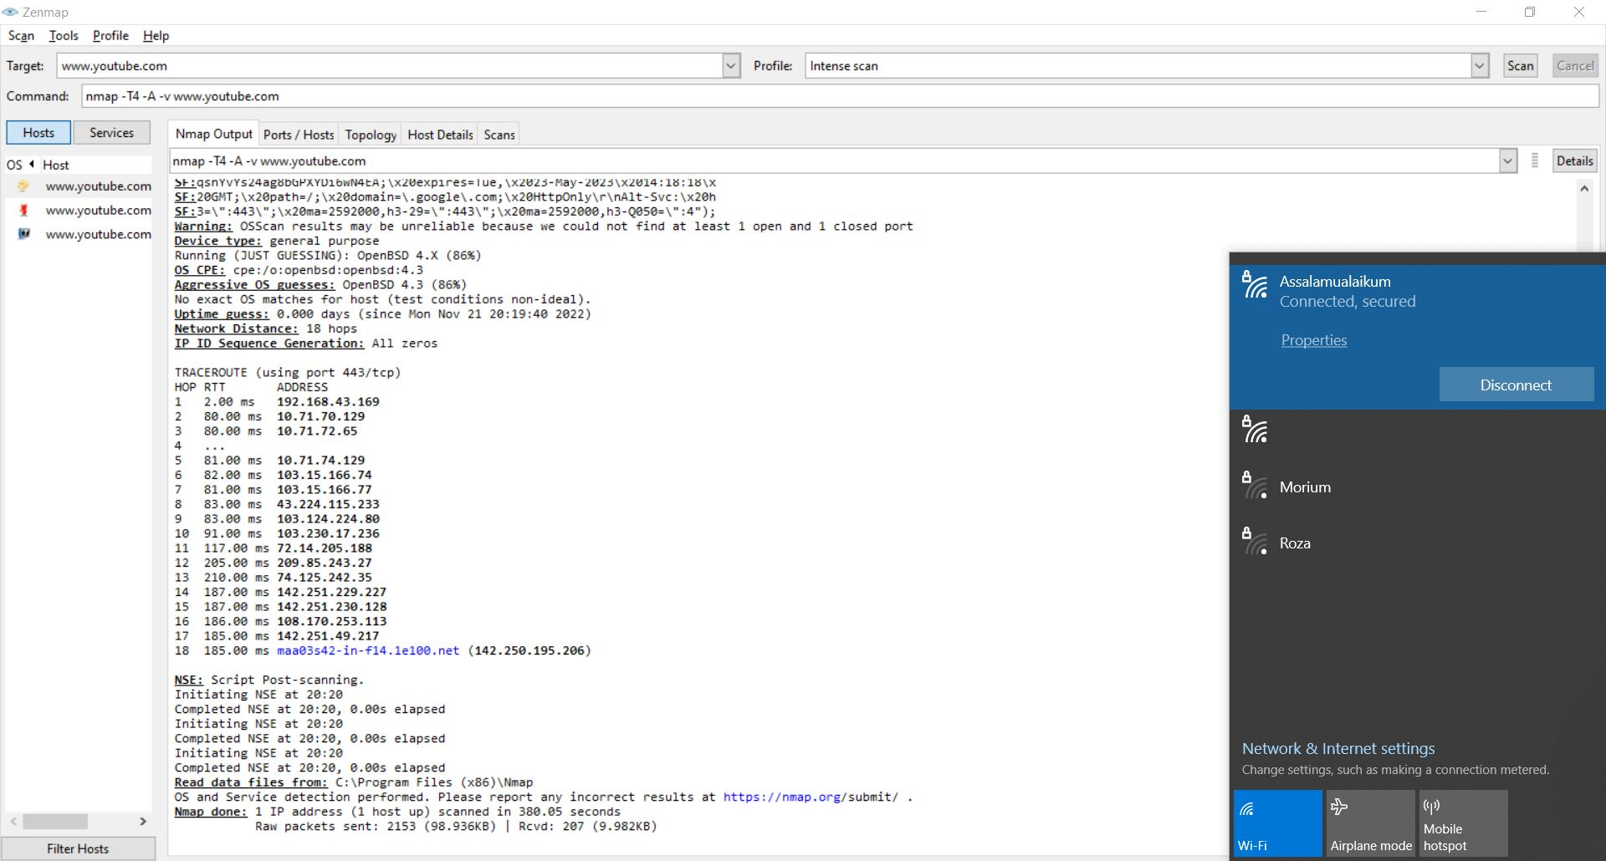
The scan result in zenmap of Banglalink ISP

Slide 9
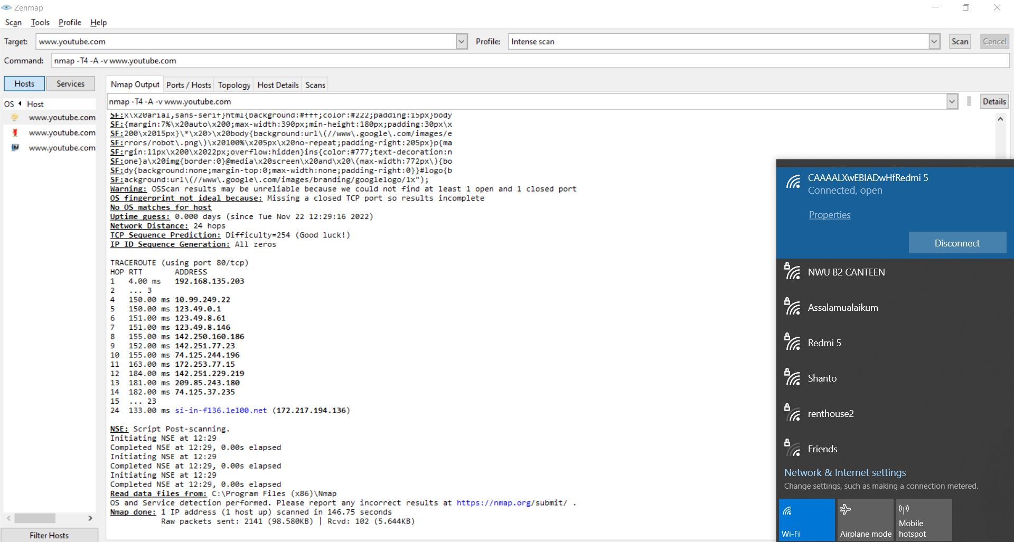
The scan result in zenmap of Teletalk ISP

Slide 10
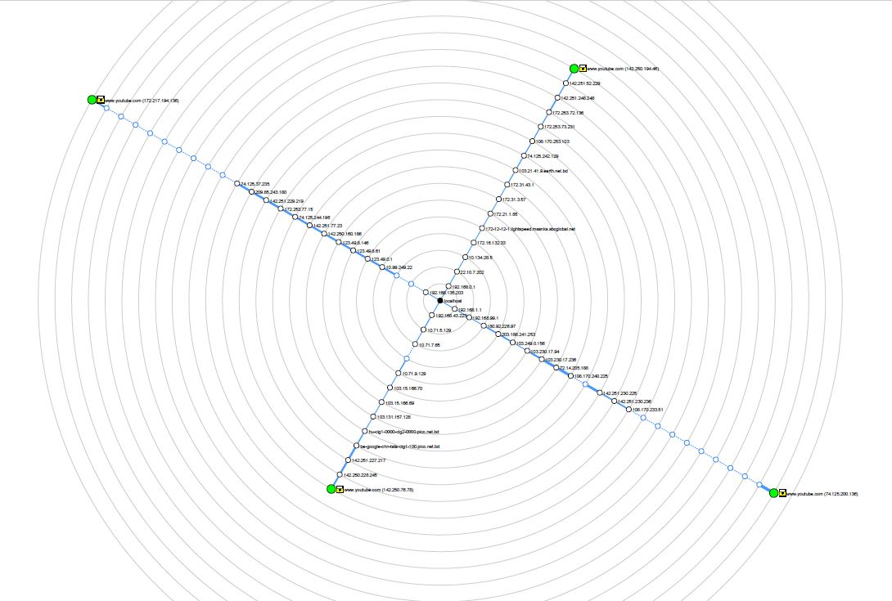
Design Network Topology
To design Network Topology we have
used 4 different networks scan in
zenmap to the domain www.youtube.com
and find the Network Topology

Slide 11
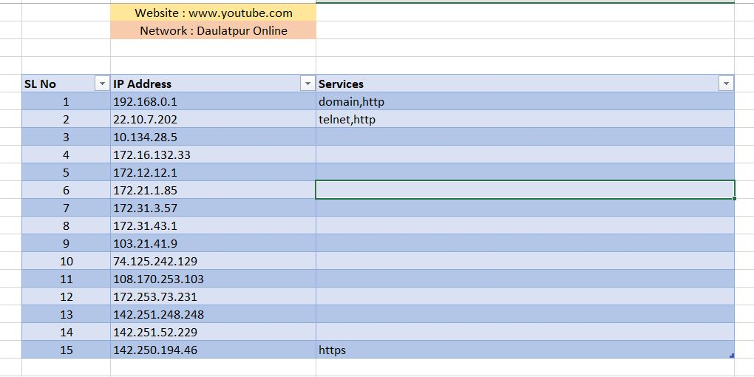
Prepare Excel Sheet for Network Diagram
To prepare the excel sheet we collect the 4 different networks’s IP addresses from the zenmap and put in the excel sheet organized level by level and store all the IP addresses and services of 4 different networks from the zenmap.
The collected IP addresses and services
from Daulatpur Online ISP in zenamp

Slide 12
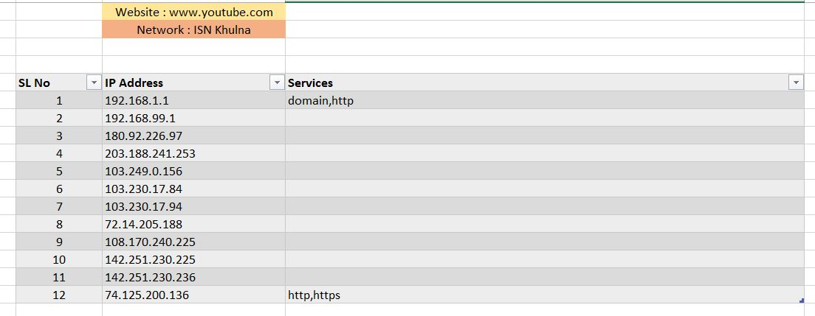
The collected IP addresses and services
from ISN Khulna ISP in zenamp

Slide 13
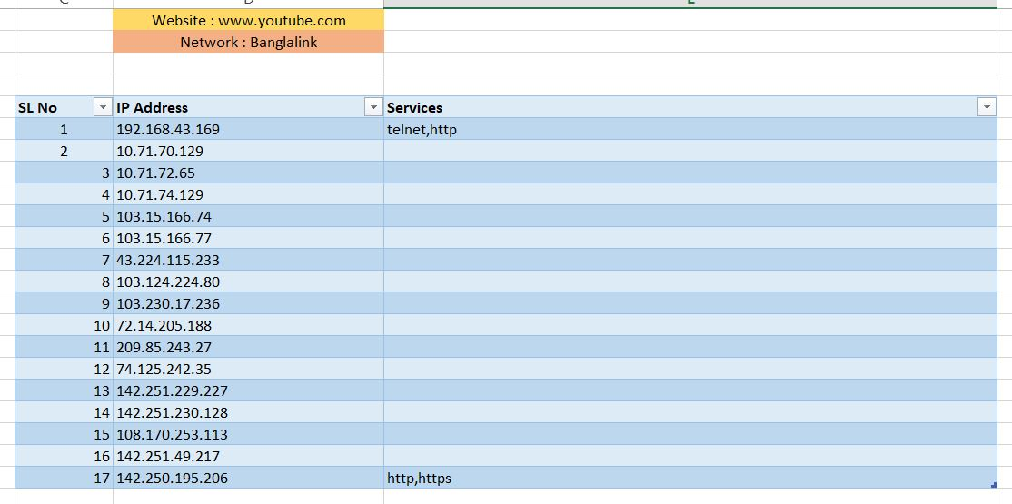
The collected IP addresses and services
from Banglalink ISP in zenamp

Slide 14
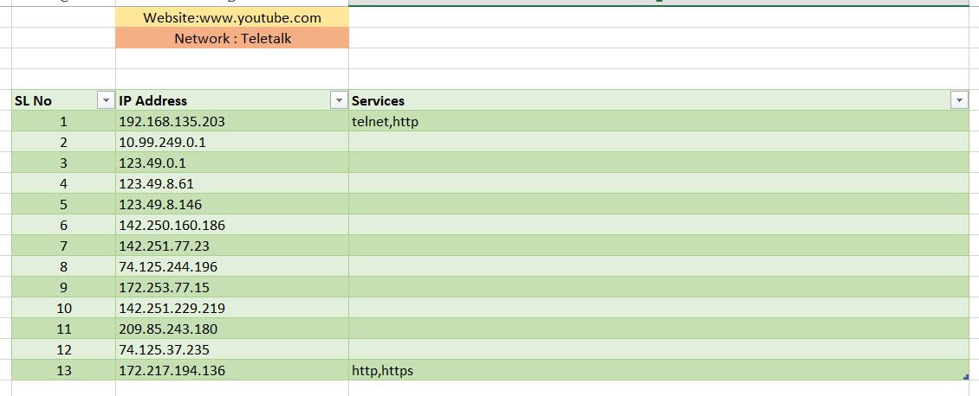
The collected IP addresses and services
from Teletalk ISP in zenamp

Slide 15
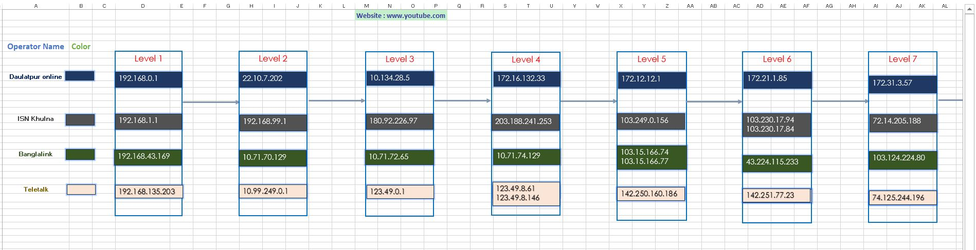
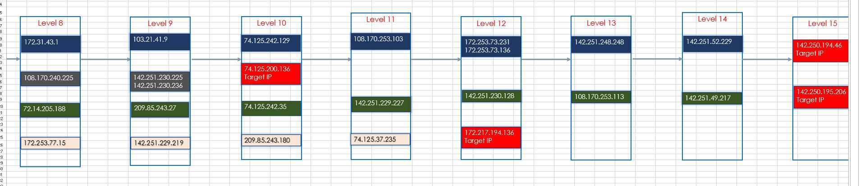
The Final Sheet of collected IP addresses organized by level

Slide 16
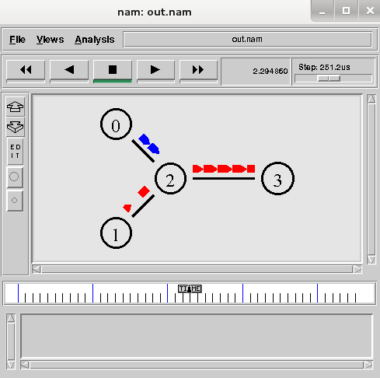
Introduction to Network Simulator 2
Useful in studying the dynamic nature of
communication networks
Simulation of network functions and protocols can be
done using NS2.
NS2 provides users with a way of specifying such
network protocols and simulating their corresponding
behaviors.

Slide 17
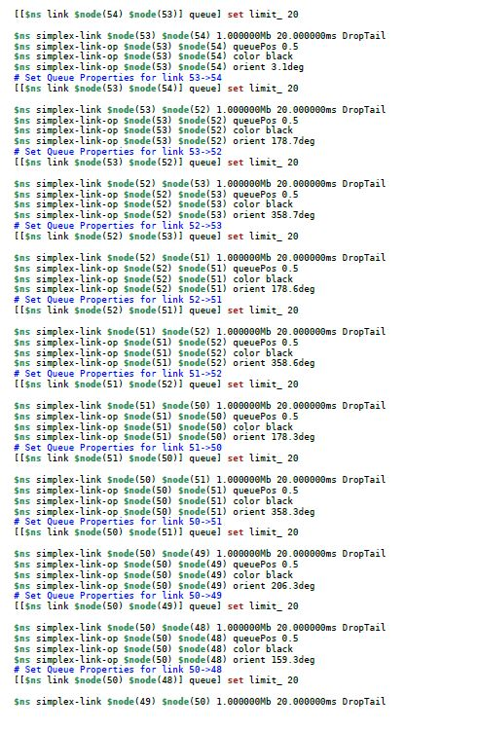
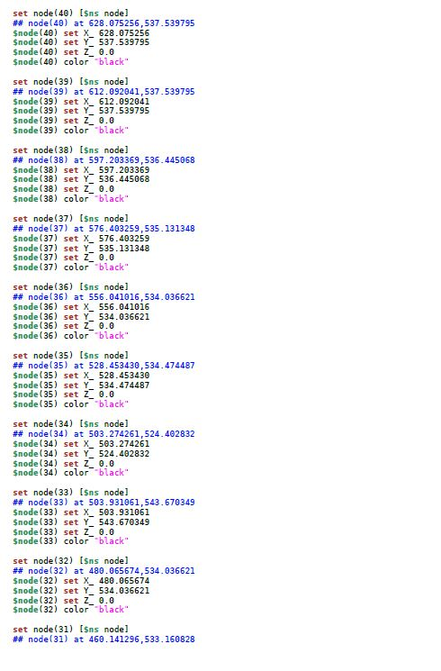
Source Code of NS2 Based on Network Diagram
The source code using to our project in NS2 (not complete code)

Slide 18
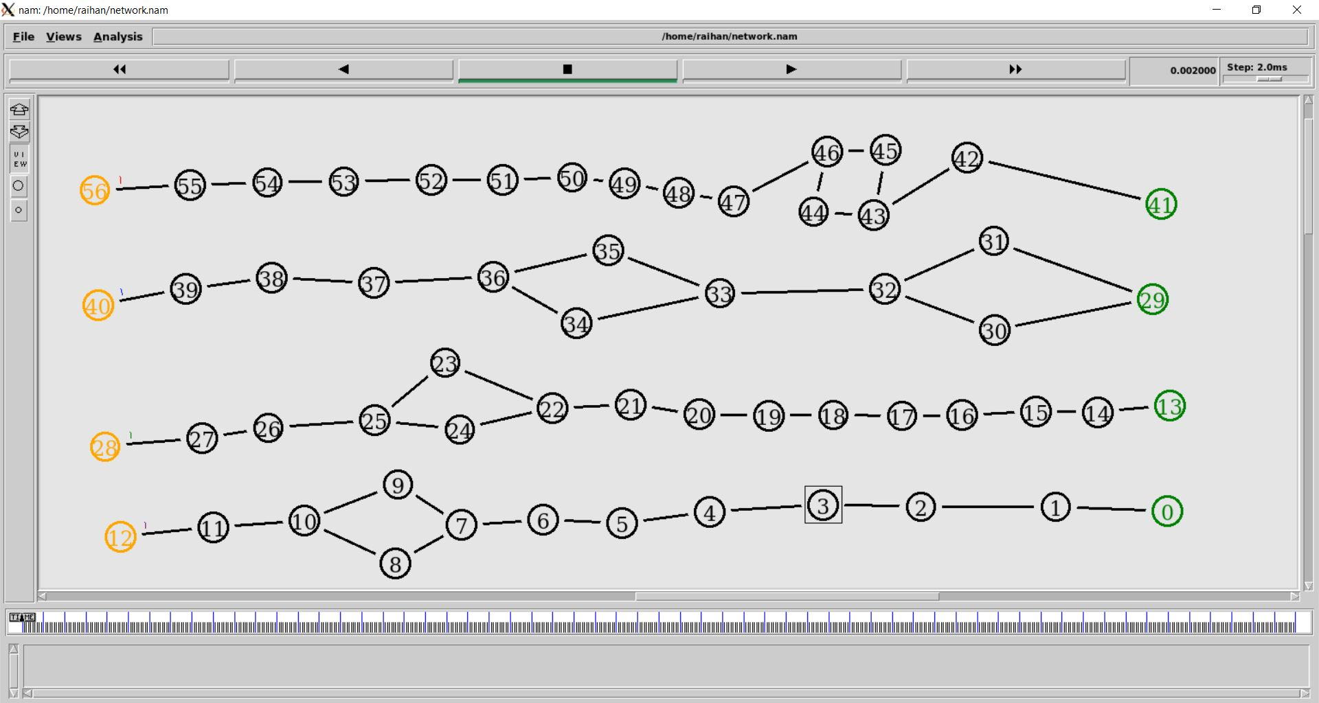
Output Topology of Network Simulator 2
The starting output of NS2 of our project

Slide 19
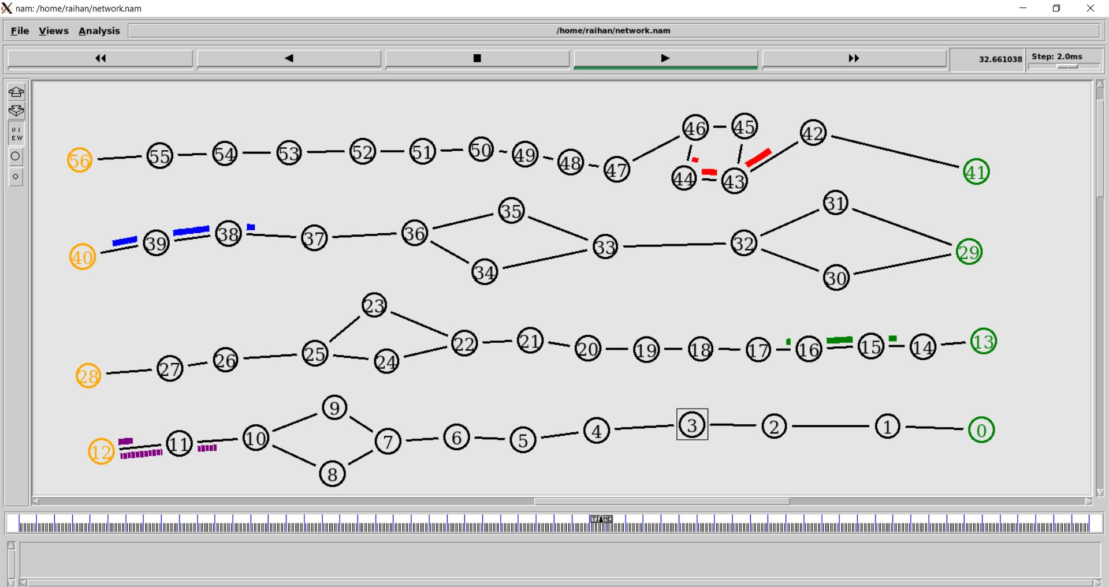
The middle output of NS2 of our project

Slide 20
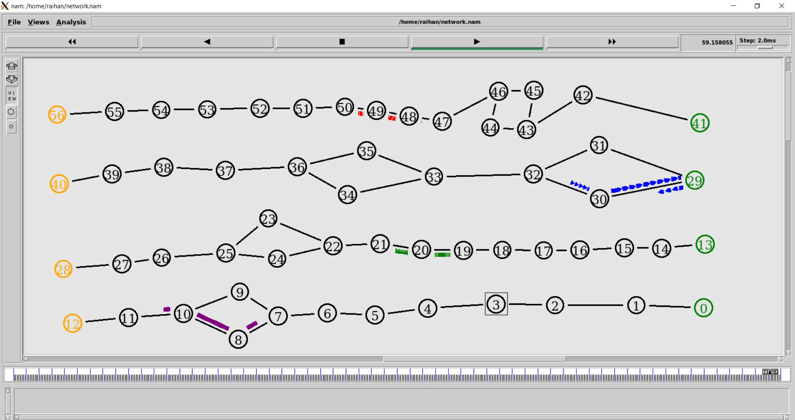
The ending output of NS2 of our project

Slide 21
Summarization of the Design Network

Slide 22
Conclusion
Its useful to know the dynamic nature of
communication networks.
Its useful to discovered networks.
But Sometimes it does not identify operating system accurately.
No option to change font style of output of NS2.

Slide 23
References
[1] https://ipwithease.com/introduction-to-zenmap-nmap
network-mapper/
[2] https://link.springer.com/chapter/10.1007/978-1-4614
1406-3_2
[3] https://nmap.org/book/zenmap-results.html

Slide 24
Thank You

